Slide 1
DESKTOP ASSISTANT
USING PUTHON VISUALSTUDIO

Slide 2
NAME : ALBAR KHAN
ROLL NO : 11
SEAT NO : 2220031
PROGRAM NAME : REG-T.Y.B.SC. CS SEM-5
COLLEGE RIZVI COLLEGE OF ARTS SCIENCE AND COMMERCE

Slide 3
INTRODUCTION
The evolution of voice-activated technology traces back to Radio Rex in 1922, a simple toy triggering actions through voice commands, predating modern computing by over two decades. Today, automation is rapidly replacing human interaction, primarily driven by technological advancements such as Machine Learning and Neural Networks. Python offers a significant library for creating virtual assistants like Siri, Alexa, and Cortana, leveraging tools like Sapi5 for Windows and Espeak for Linux to generate machine voices. Voice searches now surpass text searches, with mobile devices overtaking computer-based web searches, and it's predicted that 50% of searches will be voice-based by 2024. These advancements empower desktop assistants, streamlining daily tasks like displaying weather, setting reminders, and managing shopping lists, enhancing user productivity by effortlessly accessing information from online sources

Slide 4
REQUIREMENT SPECIFICATION
To begin crafting the Desktop Assistant project, Python serves as the foundational programming language. Start by downloading Python from the official website, ensuring it's added to your system's PATH during installation for easy command-line access. Confirm the installation by checking the Python version in your terminal or command prompt. Visual Studio Code (VS Code) acts as the integrated development environment (IDE) for coding and managing the project. Download and install VS Code, and consider adding the Python extension for comprehensive language support and debugging capabilities. Additionally, install essential Python libraries like pyttsx3 for text-to-speech, datetime for time-related operations, wikipedia for knowledge retrieval, webbrowser for web interactions, os for system-level operations, requests for data fetching, time for task scheduling, pyautogui for visual interactions, and PyQt5 if a graphical user interface (GUI) is desired. These libraries collectively enable the assistant to perform a wide array of tasks, enhancing its functionality and user experience.

Slide 5
SYSTEM ANALYSIS
System analysis for the Desktop Assistant project involves assessing the existing system's limitations, including the absence of monitoring, safety concerns, and reliance on manual alerts. This analysis drives the goal of surpassing user expectations by identifying areas for improvement. The proposed system aims to create a versatile digital assistant, focusing on key functionalities: effective voice interaction for executing commands, quick information retrieval from sources like Wikipedia, web browsing capabilities, managing applications through voice commands, and facilitating communication via messaging platforms and calls. The objective is to craft a user-centric assistant that seamlessly enhances daily tasks and interactions, aligning with the project's core objectives.

Slide 6
SURVEY OF TECHNOLOGY
Python stands as the linchpin of the Desktop Assistant project, revered for its simplicity, readability, and adaptability across various applications. Its "write once, run anywhere" ethos allows seamless code execution across platforms without recompilation. Embraced by a vast global developer community, Python's popularity spans diverse domains like web development, machine learning, and scientific computing due to its accessible syntax and extensive library support. Chosen for its user-friendly nature, Python empowers the assistant with versatile functionalities, from text-to-speech conversion through pyttsx3 to handling time-related operations via the datetime module. Modules like web browser and os facilitate web interactions and system control, while the requests library enhances data retrieval from external sources. Python's elegance and robust ecosystem serve as the foundation for creating a sophisticated, user-centric assistant, showcasing the integration of these modules and libraries to meet diverse user needs effortlessly.

Slide 7
SYSTEM DESIGN
The Desktop Assistant is a voice-activated virtual assistant designed to provide users with a seamless and interactive experience while performing various tasks on their desktop computers. This system design document outlines the architecture, modules, data flow, user interface, security measures, performance considerations, error handling, integration with external services, and potential future enhancements of the Desktop Assistant.
1. SYSTEM ARCHITECTURE
2. DIAGRAM DATA FLOW
3. DIAGRAM E-R DIAGRAM
4. FLOWCHART

Slide 8
PROJECT IMPLEMENTATION
project implementation is the process of putting a project plan into action to produce the deliverables, otherwise known as the products or services, for clients or stakeholders. it takes place after the planning phase, during which a team determines the key objectives for the project, as well as the timeline and budget. implementation involves coordinating resources and measuring performance to ensure the project remains within its expected scope and budget. it also involves handling any unforeseen issues in a way that keeps a project running smoothly.

Slide 9
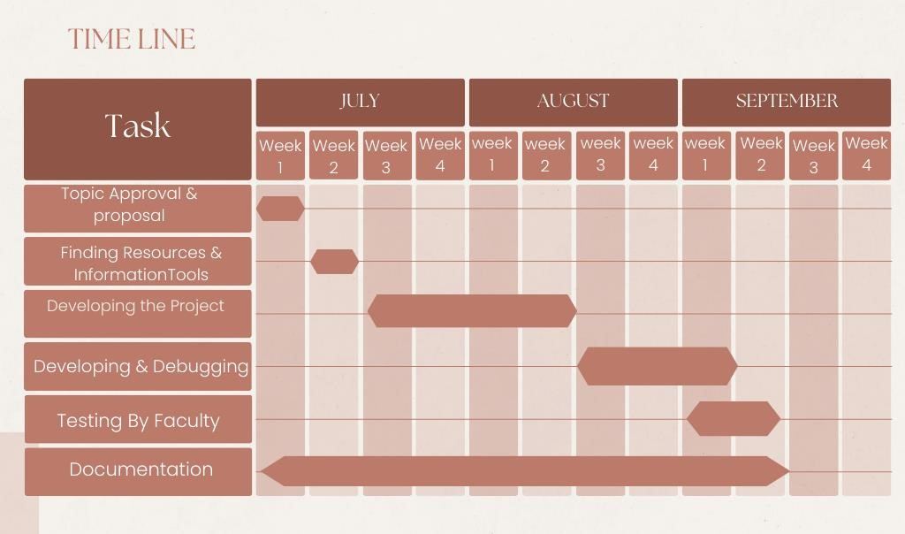
GANNT CHART

Slide 10
CONCLUSION AND FUTURE SCOPE
The Desktop Assistant project, while showcasing remarkable effectiveness in time-saving conversational interactions, faces limitations in security, potential voice interference, accent-based misinterpretations, and the inability for external calls. However, it holds expansive prospects for future enhancements. Future developments may focus on bolstering security with voice command encryption, addressing background voice interference, and refining accent interpretation for accuracy. Advanced features could encompass improved natural language processing, broader third-party app support, and adaptive learning based on user habits. Expanding compatibility across operating systems and devices, potentially through mobile apps or web-based versions, aims to widen its user accessibility. Prioritizing user privacy via advanced authentication and encryption, alongside customizable experiences tailored to user preferences, stands as promising directions for future iterations of the Desktop Assistant.

